Slide 1
Rapidly falling costs for new hepatitis C direct-acting antivirals: potential for universal access
Dzintars Gotham¹, Melissa Barber², Joseph Fortunak³, Anton Pozniak⁴, Andrew Hill⁴
¹ Faculty of Medicine, Imperial College London, London, United Kingdom.
² Centre of Development Studies, Cambridge University, Cambridge, United Kingdom.
³ Chemistry and Pharmaceutical Sciences, Howard University, Washington, DC, USA.
⁴ St Stephens AIDS Trust, Chelsea and Westminster Hospital, London, UK.
Correspondence to:
Dr Andrew Hill
microhaart@aol.com
Abstract THPDE0206

Slide 2
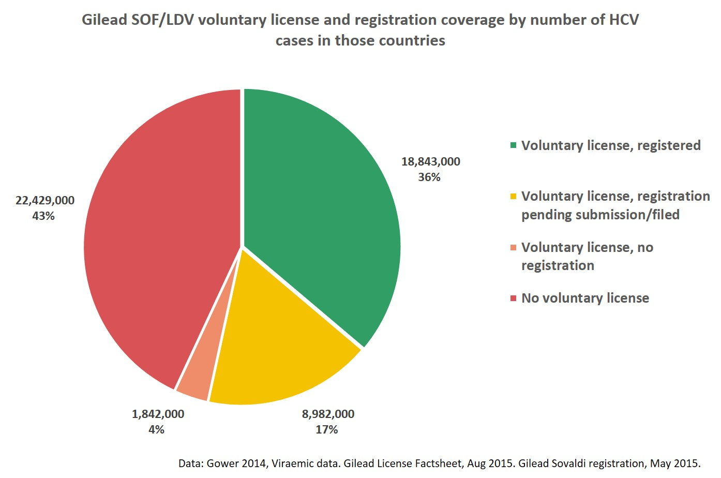

Slide 3
Cost/kg of sofosbuvir API exports Jan to Jun 2016, weighted by size of shipment
Gotham D, Barber M, Fortunak J, Pozniak A, Hill A. Rapidly falling costs for new hepatitis C direct-acting antivirals (DAAs): potential for universal access. Abstract number A-792-0516-01639, presented at AIDS2016, Durban.

Slide 4
Cost-based generic price of sofosbuvir (12 weeks)
Cost of API =
$1,094/kg
API needed per person = 34g (400mg x 84 days)
API per 12 weeks = $37
Formulation + excipients = $0.04 per pill
Formulated drug = $40
Packaging = $0.35/month
Packaged drug = $41
Profit margin = 50%
Final generic price = $62
Gotham D, Barber M, Fortunak J, Pozniak A, Hill A. Rapidly falling costs for new hepatitis C direct-acting antivirals (DAAs): potential for universal access. Abstract number A-792-0516-01639, presented at AIDS2016, Durban.

Slide 5
Costs of API, calculated target prices, and current prices
Drug | API cost/kg | Target price for finished product per treatment
Sofosbuvir (SOF) | $1,094 | $62
Daclatasvir | $998 | $14
Ledipasvir (LDV) | $2,441 | $34
SOF+LDV | N/A | $96
Velpatasvir (VEL) | $8,900-11,700 | $119-154
SOF+VEL | N/A | $181-216
Gotham D, Barber M, Fortunak J, Pozniak A, Hill A. Rapidly falling costs for new hepatitis C direct-acting antivirals (DAAs): potential for universal access. Abstract number A-792-0516-01639, presented at AIDS2016, Durban.

Slide 6
Lowest prices of sofosbuvir in selected countries
Gotham D, Barber M, Fortunak J, Pozniak A, Hill A. Rapidly falling costs for new hepatitis C direct-acting antivirals (DAAs): potential for universal access. Abstract number A-792-0516-01639, presented at AIDS2016, Durban.

Slide 7
Lowest prices of daclatasvir in selected countries
Gotham D, Barber M, Fortunak J, Pozniak A, Hill A. Rapidly falling costs for new hepatitis C direct-acting antivirals (DAAs): potential for universal access. Abstract number A-792-0516-01639, presented at AIDS2016, Durban.

Slide 8
Estimated generic price, including a 50% profit margin, for 12 weeks of treatment:
SOF: $62
SOF+DCV: $76
SOF+LDV: $96 SOF+VEL: $181-$216

